Slide 1








End of Course
Summary
Take-aways
Limits of the models
Exercises
Going further

Slide 2
Summary
Corporate Community Boosting encompasses many functions, including managing value, content and people.
There is a strong competition in catching attention. Such condition invites CCBs to select the right format according to scalability or undivided attention, balance actions between reach strategy and engagement strategy, and select when to curate and when to create.
A community must deliver value, and it is better done when target value is identified, when value momentum is exploited, and when value delivery is made compatible with whatever already exists in the Corporation, like other communities.
As far as people are concerned, CCBs must manage the stakeholders' expectations. One target for resilient growth is to set up a Golden Engagement virtuous circle, which requires understanding of engagement pros and cons for Community Members. Levels of engagement can be outlined, in order to better understand members’ time investment profiles, expectations and propose the right level of opportunities to everyone, keeping them in the Engagement flow. These levels of engagement also help in defining a Community Engagement target and help in clarifying what blocks or accelerate Engagement dynamics (walls and jumps).
Engagement level can also depend on the level of link between members, which can be defined using various dimensions, measured, and fostered, especially when members become numerous. Link architecture and dynamics are also to be considered when deciding a strategy.
The power given to Community Boosters comes with responsibilities, and Community Booster should consider ethical questions about their activities.

Slide 3
Take-aways
Frames of reference:
7 levels of engagement in content
7 levels of engagement
Concepts
Community Desert Circle
Community Engagement Target
Engagement Walls
Engagement Jumps
Other
Key stories and examples
Value-Content-People
Golden Engagement Circle
Value Momentum
Engagement flow
Link Definition, architecture, Community Artifacts

Slide 4


Summary : List of Corporate Community Challenges 1/2
Value Challenges
Content Challenges
Catch attention in a noisy environment
Locate the value of your Corporate Community
Exploit value momentum
Manage your Community Borders
Get a click / touch
Know how catchy you can be
Choose the right content format, balancing scalability and undivided attention
Know your next move
Engage audience in your content
Understand the Community Desert Circle
Choose between creating and curating

Slide 5

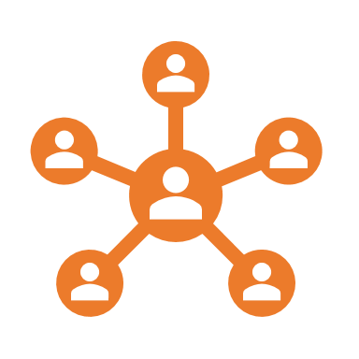


Summary List of Corporate Community Challenges 2/2
People Link Challenges
Other Challenges
Identify Link dynamics
Assess the importance of Link
Figure out 360 expectations
Understand the limits of links for an individual
Choose how you define Link
Measure Link
Understand how link, numbers and engagement work together (or not!)
Identify Patterns in your link architecture
Embrace Community Boosters Ethics
People Engagement Challenges
Manage sponsors & hierarchy expectations
Measure your Community performance
Understand your own version of the Golden Engagement Circle
Identify members’ Engagement and available time
Outline members’ time investment profiles
Understand Engagement Flow
Outline for each Engagement level what are the Gives & Takes
Identify example activities & content for each level
Set up a Community Engagement Target
Identify Engagement Walls
Identify and design Engagement Jumps

Slide 6
Limits
Every course, every model, no matter how powerful and adaptive, has its limits. It is important for learners to identify some unanswered questions, some assumptions that could be challenged, some development paths.
We hope that listing a first set of limits of this course will encourage learners to keep being curious, to keep upgrading the course, and keep learning beyond.
Short and non exhaustive list of interesting, yet unanswered, questions
How to manage User Generated Content ? How to manage conflicting expectations ? How to create sub-communities or join a super community ? How to balance sense of belonging, loss of involvement ? How to manage Community organic generation of culture ?
Short and non exhaustive list of assumptions that could be challenged
Communities rely on content Engagement follows the interpretative framework of reference “7 levels” Engagement persists Catching attention is difficult Engagement can be broken down into pieces and put in a linear model
Short and non exhaustive list of further development paths for this course
Frame of reference for Engagement Walls and Jumps

Slide 7

Exercises
Tackle with your Community Booster Challenges now !

Slide 8









Exercise #1 : Write down REAL expectations of your Current corporate Community Stakeholders & identities (real people) as example profiles
Top Management
Non-sponsoring Hierarchy
Sponsors
Value
Content
Non-active members (passive consumers)
Active members
Corporate Community Booster
Potential members
New members

Slide 9

Exercise #C2 Brainstorm ideas on how you would get clicks on your Community content
Catchy titles
LOOK HERE
IN THIS
THUMBNAIL
Example :
Everything you need to know about our Community in 5 minutes
Example :
Add John’s image in the thumbnails (people love John)

Slide 10
Exercise #C4 Define or select content format for your Community Content, include next moves
Scalability (easiness of consumption by many people)
Undivided attention

Slide 11
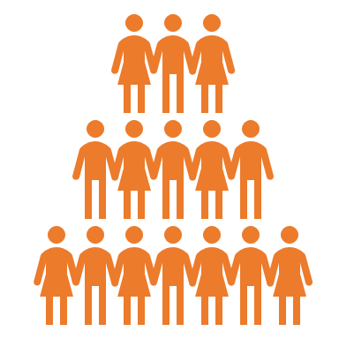






Exercise #C5 Brainstorm actions for reach or for engagement in your current Community
Increase reach :
Target more people
Increase engagement :
Target further engagement

Slide 12



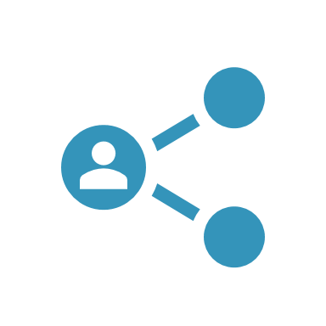




Exercise #C6 : Identify content walls, current stop points
1) Attention !
“Look here quick !”
Our content deserves to be opened
2) Activation
“Give a try, it’s easy”
Our content deserves to be consumed (read, listened, watched, played …)
3) Value confirmation
“Give us a rating (or a like!)”
Our content is valuable enough to be validated
4) Contribution
5) Sharing
“Give us your comments !”
“Please share”
Our content is important enough to be discussed (social content is added to the content)
6) Reference
Our content is important enough to be shared
“Feel free to mention”
Our content is valuable enough to be used as a reference in other content
7) Gathering
“Join the others”
Our content is good enough for people to gather by themselves around
Example : People need to login to give a like
Example wall : No comment engine in our content platform
Example : 30% stop here

Slide 13





Exercise #C8 List what you will create and what you will curate
What we will create
Both
What we will curate
Example : Articles about …

Slide 14
Exercise #V1 Locate the value of your Corporate community Write down your Community activities in each quadrant
Direct business value
Example : Business opportunity sharing community
Example : Cybersecurity Community
Example : Company’s Football club
Example : Corporate Alumni
Value is mostly for members
Value is for members and nonmembers
Indirect business value

Slide 15


Exercise #V2 Write down how you would exploit the momentum of key value you create
Example
Every time we have a successful event
Send a mail and invite people to join the Community
Ask members to post the picture of them in the event

Slide 16

Exercise #V3 Identify another Community with which you have borders. Write down your possibilities
Compete
The best way wins or dominates
Integrate
Synergy
Differentiate
A & B end up providing different values to different segments
Market specialization
A & B have different ways to provide the value
A & B merge their powers
Content Curation, Common events, Common structures & processes
Common governance to define
Co-Define the borders and Co-define the segments. Redirect.
Agree on value segments
Our Community
Community B

Slide 17
Exercise #P1 Identify expectations
Top Management
Non-sponsoring & involved hierarchy
Sponsoring hierarchy
Explicit expectation
Implicit expectation

Slide 18


Exercise #P2 Brainstorm Community performance indicators

Slide 19






Exercise #P4 List reasons for disengagement and ideas for engagement
Arguments to engage in the Community
Value provided by the Community on a professional level
Value provided by the Community on a personal level
Arguments to disengage from the Community
Professional priorities
Logistical constraints
Personal priorities
Logistical convenience of community activities

Slide 20








Exercise #P4, 5, 6 Outline engagement levels, then time investment profiles, give & take, activities and content for each level
Engagement level name
Time investment profile
What people are ready to give
What people expect
What your community can provide

Slide 21


Exercise P9 Represent your Engagement Target (copy paste for numbers)
Target number or %
Target number or %
Target number or %
Target number or %
Target number or %
Target number or %
Target number or %
“You got my attention” | “I want to experience something” | “I want reasons to come again” | “I want to feel involved” | “I want to lead something” | “I want to add my own touch” | “I want to gather people around this topic”
Range Name

Slide 22
Exercise P10 Identify your engagement Rear walls
Level Name
Level Name
Level Name
Level Name
Level Name
Level Name
Level Name

Slide 23
Exercise P10 Identify your engagement Front walls
Level Name
Level Name
Level Name
Level Name
Level Name
Level Name
Level Name

Slide 24

Exercise P11 Identify ideas for Front Jumps
Level Name
Level Name
Level Name
Level Name
Level Name
Level Name
Level Name

Slide 25
Exercise P11 Identify ideas for Rear Jumps
Level Name
Level Name
Level Name
Level Name
Level Name
Level Name
Level Name

Slide 26


Exercise P12 Identify reasons why Link is not important, and why it is
Link is not important because…
Link is not important because…
Link is not important because…
Link is not important because…
Link is important because…
Link is important because…
Link is important because…

Slide 27



Exercise P13 Define what type of Links you want to foster, and key activities you prioritize
Link in our community means…
Therefore, we will focus more on …
Example : Sharing emotions and problems
Example : Co-development sessions

Slide 28
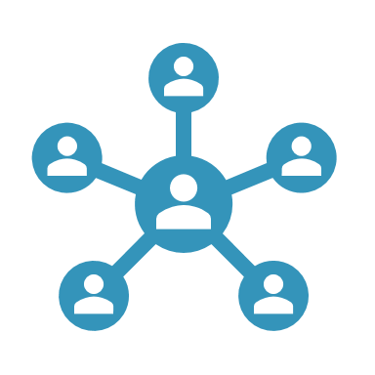



Exercise P14 Define how you will measure Link
We will measure link in our community with the following indicators …

Slide 29






Challenge P16 Choose your artefacts and display them on a timeline
WHAT :
We will define / co-create the following artifacts
Example : Community Charter
WHEN:
These artifact will be used when…
Example :
When we reach 50

Slide 30






Exercise P19 Identify elements that will influence Link in your Community Identify how you will exploit or compensate them
WHAT will increase Link no matter what we do as Community Boosters
Example : Christmas holidays
Example : Organize a Christmas party
HOW we can exploit this positive influence
HOW we can compensate the negative influence
Example : Mix teams from the two conflictual managers
WHAT will decrease Link no matter what we do as Community Boosters
Example :
Recent Conflict between managers

Slide 31
Exercise P20 Identify ethical questions and propose answers
Ethical question
Example : How will we manage privacy ?
Example :
Idea : allow all users to delete their account, remind them
Example :
Use nicknames instead of real names
Solution

Slide 32

Going further
To infinity and beyond current knowledge and know-how

Slide 33
Going Further
Other courses
Viral Transformation Concepts : Understanding the Viral approach to learning and knowledge sharing
#OSG Method Basics : Overview of the #OSG method
Setting up #OSG method in your Community in 10 steps : How to Start #OSG for your Community !

Slide 34

Viral Transformation Concepts
Course pitch and content summary
Viral transformation is a new way of thinking large scale education and formal training. Discovers what are the big ideas, inspirations and concepts that you can adapt afterwards in your organization.
What is Viral Transformation ?
Why foster Viral Transformation ?
How do we foster Viral Transformation ?
Models & Examples
Factors of Viral Transformation

Slide 35

#OSG Method Basics
Course pitch and content summary
The #OSG Method is a framework to help Communities grow in numbers, engagement, by developing their knowledge sharing power, using Viral learning as a mindset and Engagement levels as a backbone. Discover the big ideas behind the method used in large, small, profit and non-profit organizations for their Communities development.
History and goal of #OSG Method
Value-focused stories, ideas and tools
People-focused stories, ideas and tools
Content-focused stories, ideas and tools

Slide 36

Setting up #OSG in 5 steps
Course pitch and content summary
#OSG method is made to be implemented, practiced, applied, learned and understood. This course help you set up #OSG method for your Community in 5 easy steps
Overview : Framing what you want first,
Value : Set up value targeting process , improvement process, promotion processes
Members : Defining, promoting, and following up #OpenSeriousPath
Content : Increase the range, easiness to share, and lasting power of your content
Further development : Foster virtuous circles, Keep on innovating

